Slide 1

Module 4: Evolutionary Dynamics and Molecular Epidemiology of Viruses
Instructors: Julia A. Palacios and Nicola Müeller

Slide 2
Logistics
Slides and tutorials.
Break 3:00-3:30pm.
Enrolled: 24 graduate students, postdocs, professors and researchers.
Your participation is encouraged!
https://juliapalacios.github.io/SISMID_EvolutionaryDynamics/

Slide 3
Evolutionary dynamics and molecular epidemiology of viruses
The goal is to:
Understand patterns of transmission and spread (effective population size)
Estimate the rate of evolution / mutation rate
Compare evolution across pathogens
Understand the sources of molecular variation (mutation, selection, recombination)
Surveillance
Molecular epidemiology and phylodynamics of infectious diseases aim to study
infectious disease behavior through a combination of evolutionary, epidemiological
and immunological processes from molecular variation [Holmes and Grenfell, 2009].

Slide 4
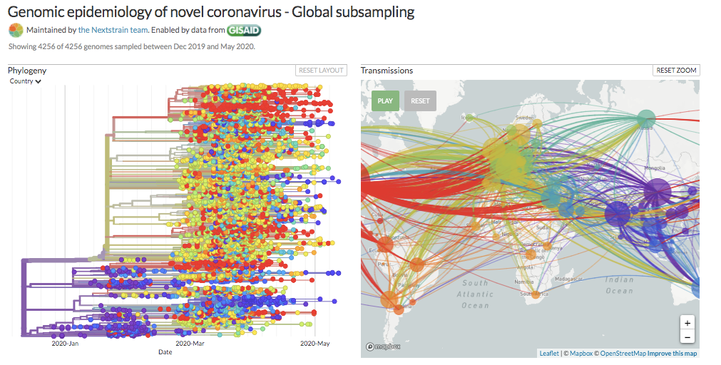
Global spread of SARS-CoV-2

Slide 5
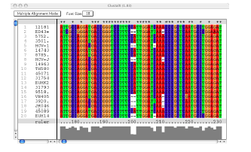
Observed data
Biological sequences (DNA, RNA, protein) contain information about their underlying evolutionary processes.
Molecular sequences from different organisms are not independent because they share evolutionary history.
The central concept is a genealogy: a bifurcating tree that depicts the ancestral relationships of the samples.

Slide 6
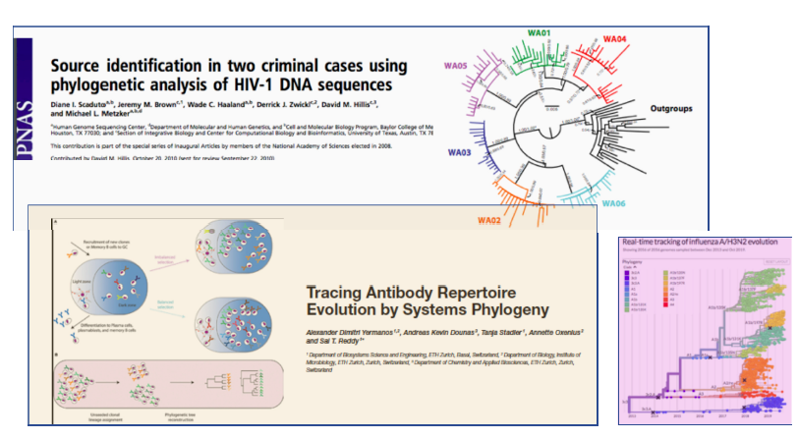
Estimation of genealogies and phylogenies has allowed …

Slide 7
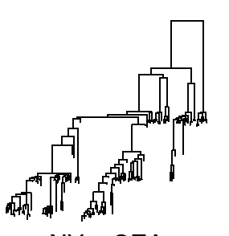
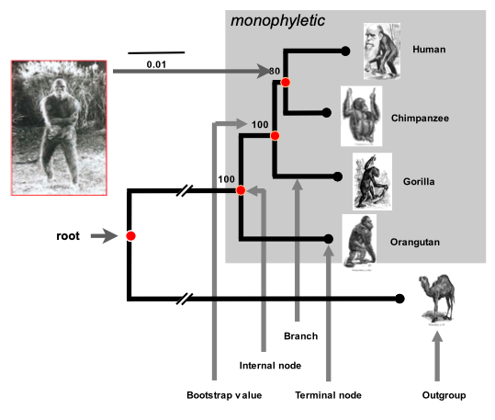
What is a genealogy?
Genealogy
Phylogeny
Time
Tips correspond to individuals
Internal nodes are ranked
Branch lengths are in the same scale
Samples are time stamped (tips)
Tips correspond to species
Usually internal nodes are not ranked
Branch lengths are in different scales
Unrooted trees are commonly analyzed

Slide 8
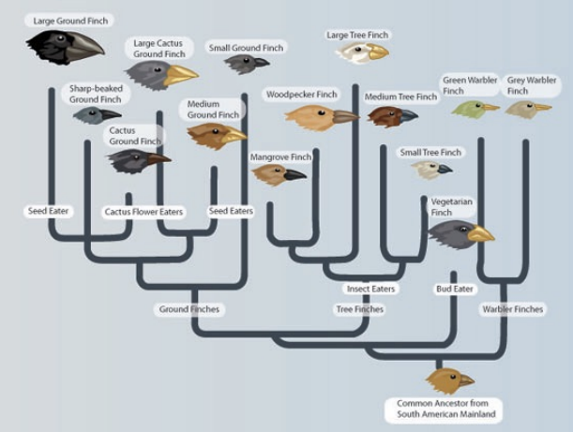
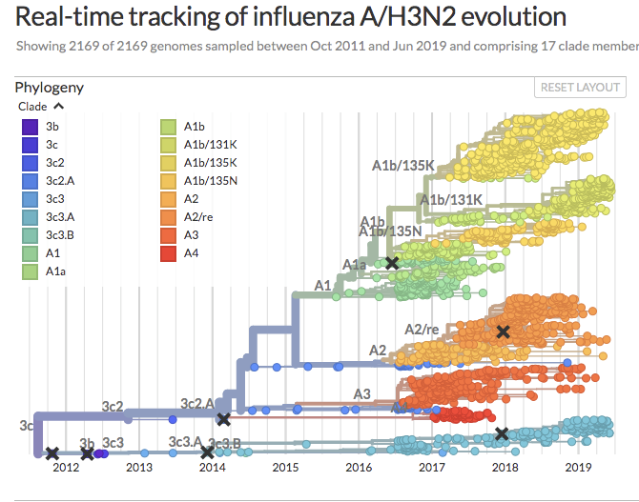
Phylogenetics, phylodynamics and population genetics
Phylogenetics is the study of the evolutionary history of species. It seeks to determine the “family tree”.
Understanding selection
Evidence for coevolution
Pathways of trait evolution
Phylodynamics
Attempts to enhance understanding of infectious disease dynamics using pathogen phylogenies

Slide 9
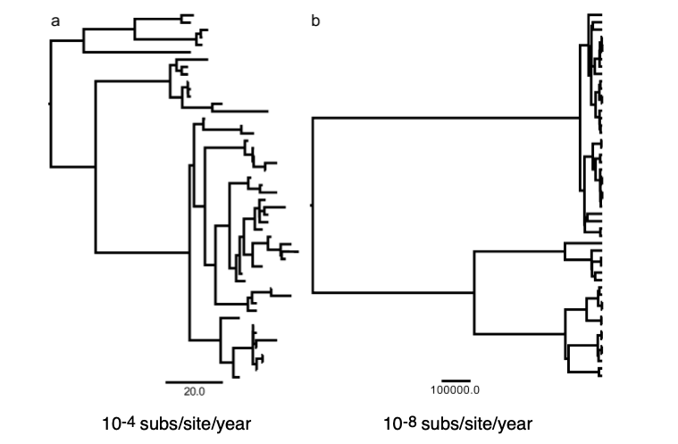
Phylodynamics and population genetics
For rapidly evolving organisms
For slowly evolving organisms

Slide 10
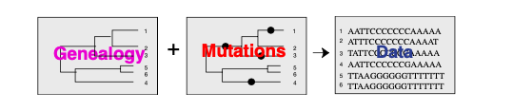
Statistical phylogenetics seeks to infer the phylogeny from molecular data
Genealogies inform about past evolutionary history.
Ancestry
Signatures of selection
Population structure
Population history

Slide 11
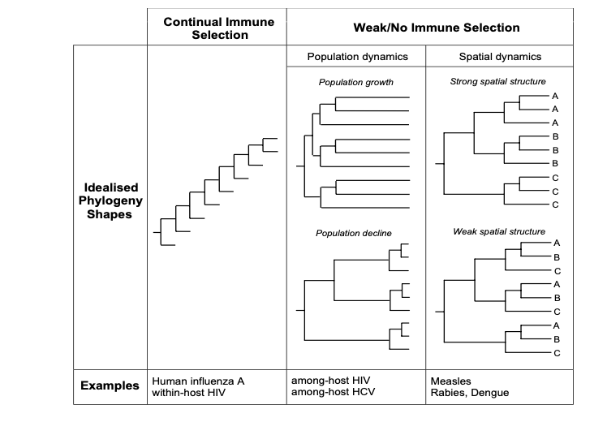
Phylodynamic patterns inform about selection and population structure

Slide 12
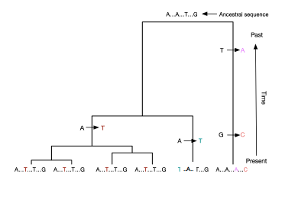
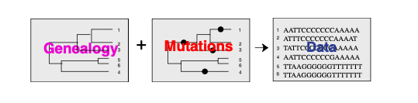
A process of substitutions superimposed on the genealogy generates observed sequences at the tips of the genealogy

Slide 13
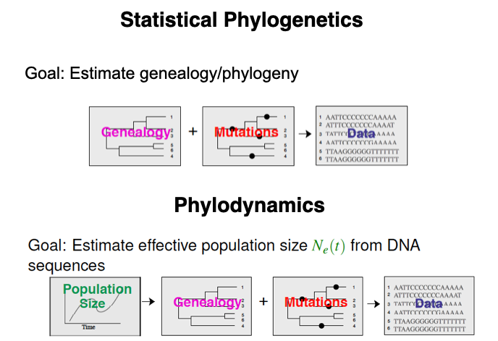
Coalescent Process

Slide 14
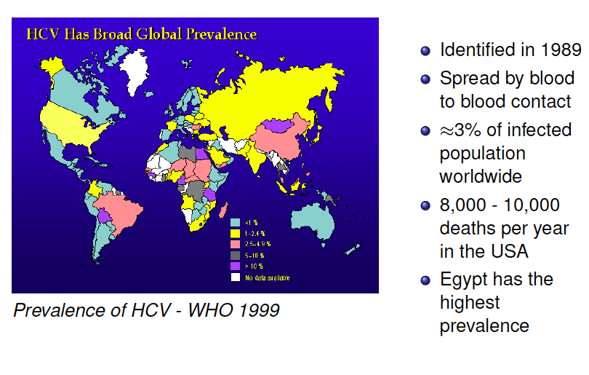
Example 1: Hepatitis C in Egypt

Slide 15
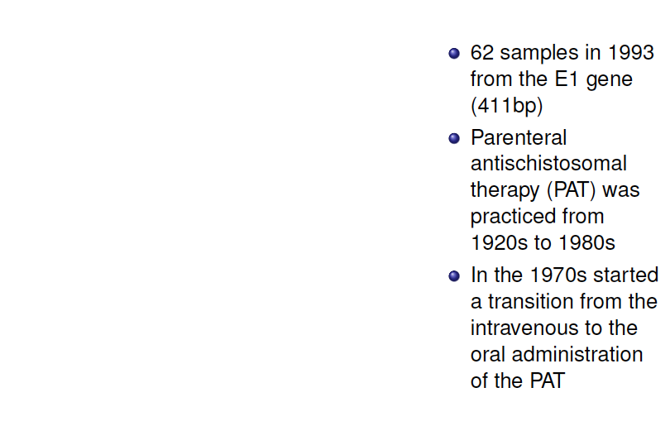
Example 1: Hepatitis C in Egypt

Slide 16
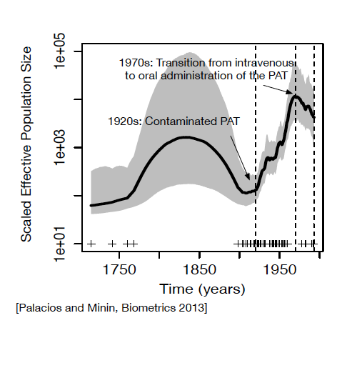
Example 1: Hepatitis C in Egypt

Slide 17
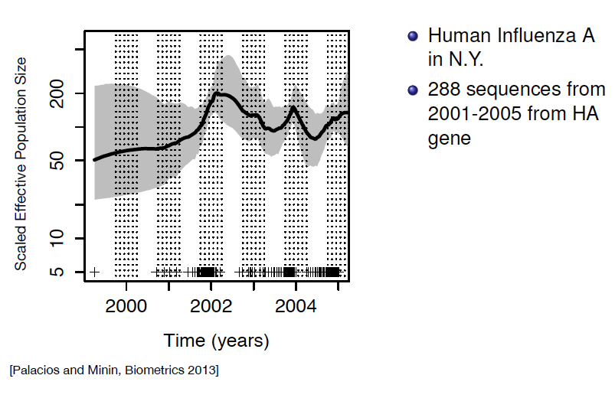
Example 2: Influenza in NY

Slide 18
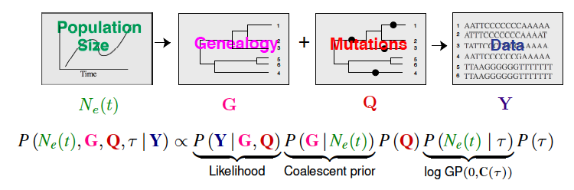
Bayesian Evolutionary Analysis by Sampling Trees
Posterior
Birth-death prior
Piece-wise constant (deterministic)
Parametric prior

Slide 19
Frequentist vs Bayesian Inference
Frequentist
Probability is interpreted as long run frequency.
The goal is to create procedures with long run guarantees.
Procedures are random while parameters are fixed and unknown
Bayesian
Probability is interpreted as a measure of subjective degree of belief
Everything is regarded as random
Goal is to quantify and analyze degrees of belief
Larry Wasserman –All of Statistics

Slide 20
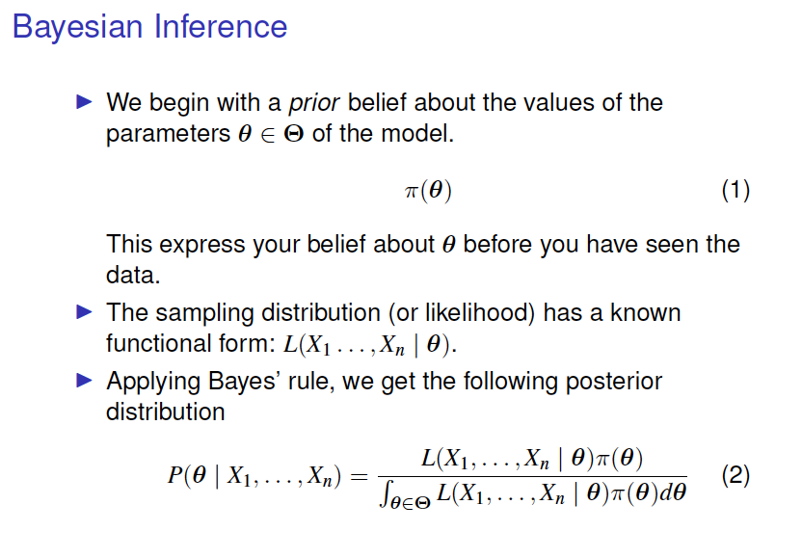

Slide 21
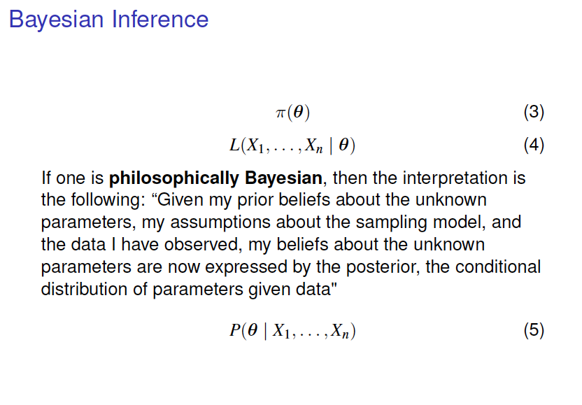

Slide 22
Example: Poisson-Gamma
Suppose your observations are a realization from a Poisson distribution with parameter λ =1
You don’t know that λ =1
You have a prior belief that λ may behave as a Gamma(.1,1)

Slide 23
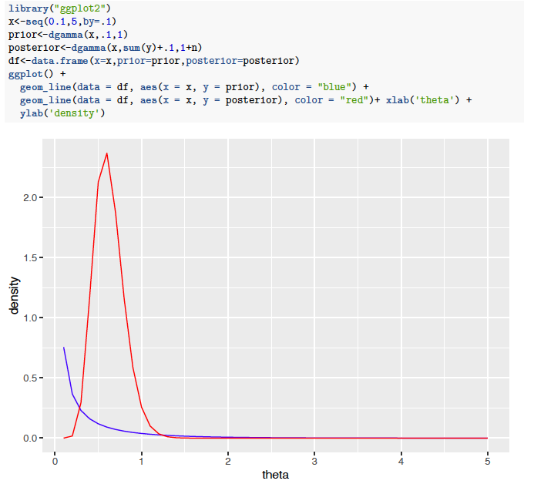
Example: Poisson-Gamma

Slide 24
Bayesian Evolutionary Analysis by Sampling Trees
Posterior
Birth-death prior
Piece-wise constant (deterministic)
Parametric prior

Slide 25
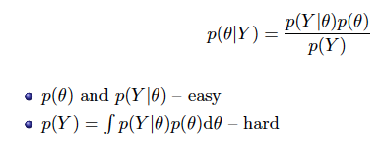
Bayesian Evolutionary Analysis by Sampling Trees
Posterior
Birth-death prior
Piece-wise constant (deterministic)
Parametric prior
Target of interest:

Slide 26
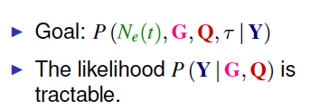
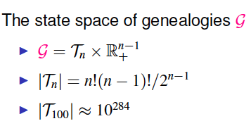
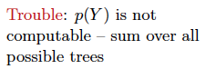
Bayesian Evolutionary Analysis by Sampling Trees

Slide 27
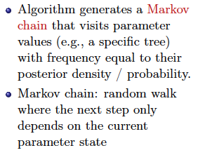
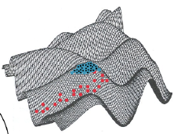
Markov Chain Monte Carlo
Marc Suchard – Past SISMID

Slide 28
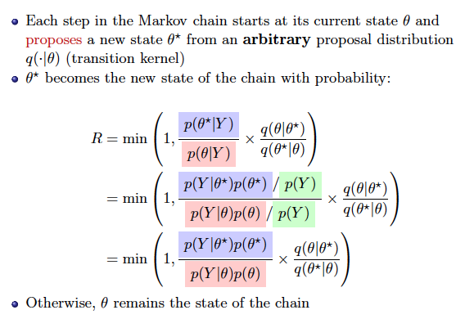
Metropolis-Hastings Algorithm
Marc Suchard – Past SISMID

Slide 29
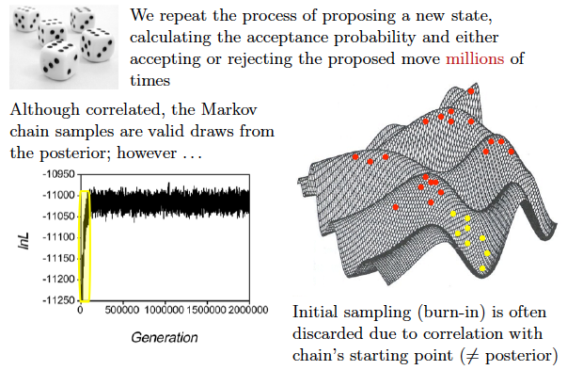
Metropolis-Hastings Algorithm
Marc Suchard – Past SISMID

Slide 30
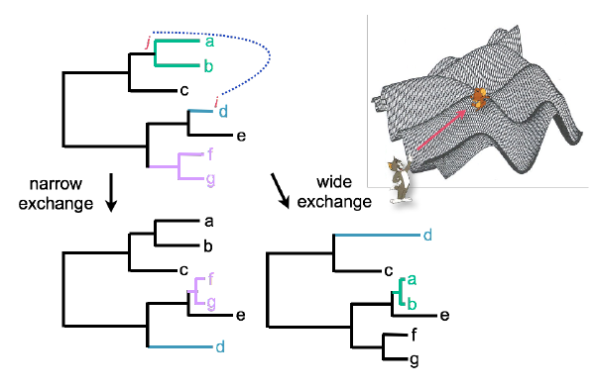
Transition kernels
Marc Suchard – Past SISMID

Slide 31
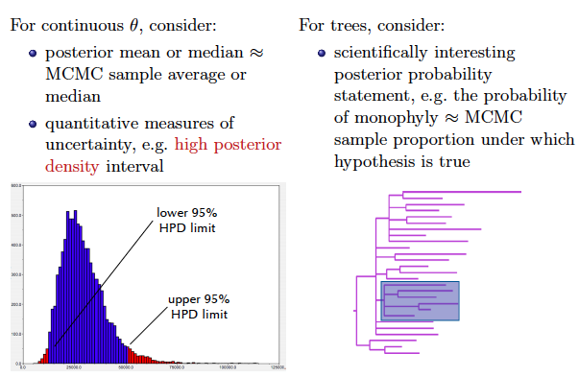
Posterior summaries

Slide 32
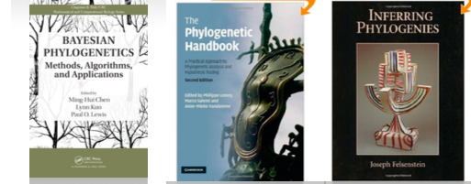
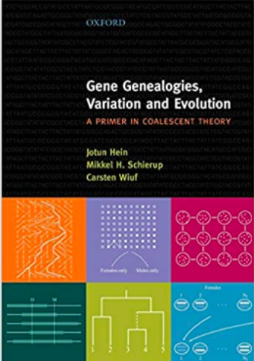

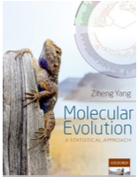
Book references

Slide 33
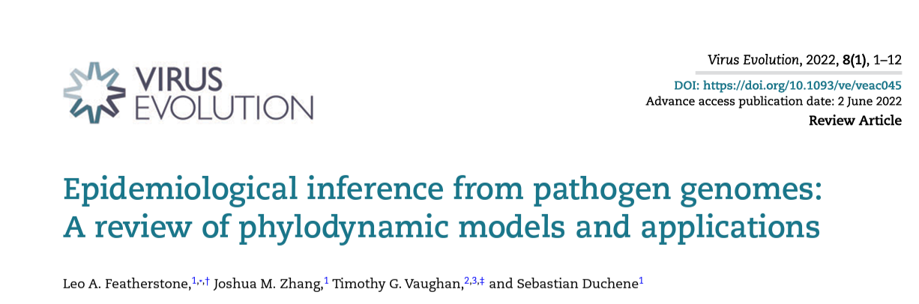
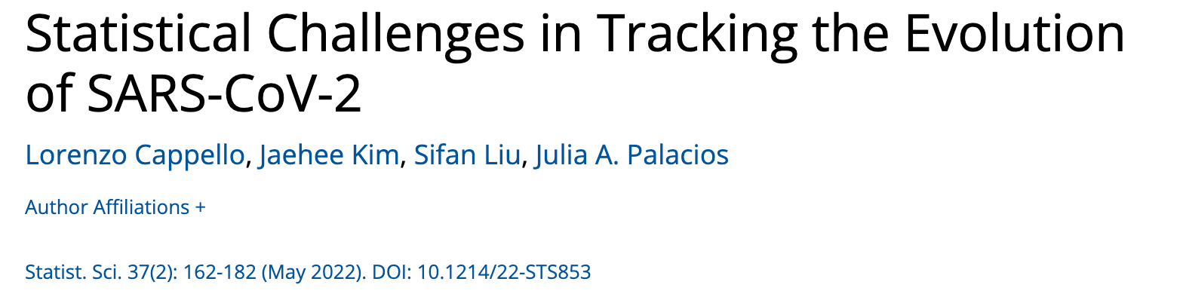
Recent review papers

